Slide 1
UNICS and LINUX commands
(7 Chapters)
2020-2021(even) Linux Commands

Slide 2
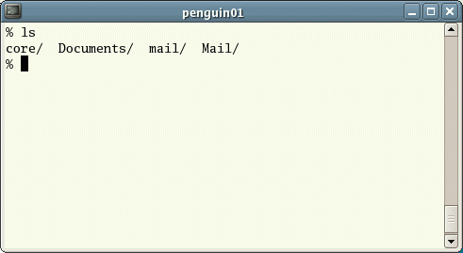
Chapter 1
Listing files and directories
ls (list)
When you first login, your current working directory is your home directory.
Your home directory has the same name as your user-name, for example, os, and it is where your personal files and subdirectories are saved.
To find out what is in your home directory, type
% ls
The ls command ( lowercase L and lowercase S ) lists the contents of your current working directory.
2020-2021(even) Linux Commands

Slide 3
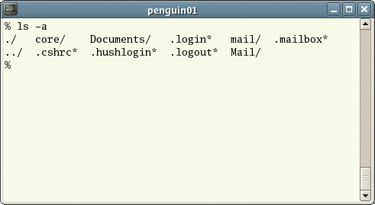
Listing files and directories
ls does not, in fact, cause all the files in your home directory to be listed, but only those ones whose name does not begin with a dot (.) Files beginning with a dot (.) are known as hidden files and usually contain important program configuration information.
They are hidden because you should not change them unless you are very familiar with UNIX!!!
To list all files in your home directory including those whose names begin with a dot, type
    % ls -a
As you can see, ls -a lists files that are normally hidden.
2020-2021(even) Linux Commands

Slide 4
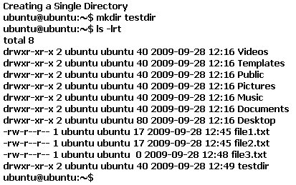
Making Directories
mkdir (make directory)
We will now make a subdirectory in your home directory to hold the files you will be creating and using in the course of this tutorial. To make a subdirectory called unixstuff in your current working directory type
% mkdir unixstuff
To see the directory you have just created, type
% ls
2020-2021(even) Linux Commands

Slide 5
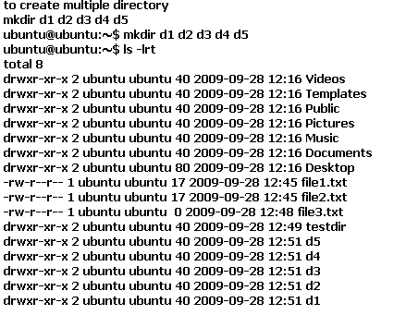
Making Directories
2020-2021(even) Linux Commands

Slide 6
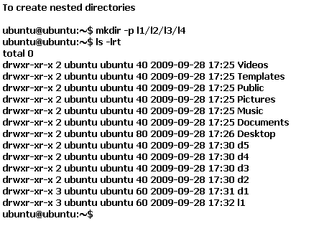
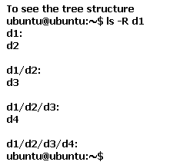
Making Directories – Little Play
2020-2021(even) Linux Commands

Slide 7
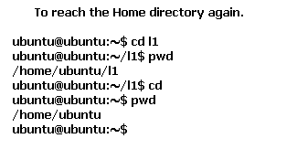

Change Directory (cd)
Cd ~ will also take you to your home directory ☺
2020-2021(even) Linux Commands

Slide 8
The parent directory (..)
(..) means the parent of the current directory, so typing
% cd ..
will take you one directory up the hierarchy (back to your home directory). Try it now.
2020-2021(even) Linux Commands

Slide 9
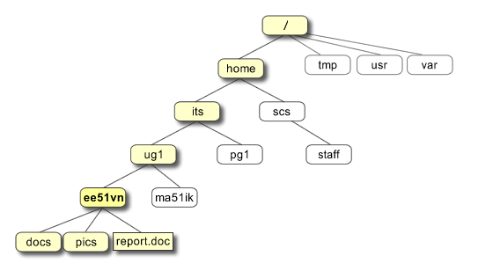
pwd (print working directory)
Pathnames enable you to work out where you are in relation to the whole file-system. For example, to find out the absolute pathname of your home-directory, type cd to get back to your home-directory and then type
% pwd
The full pathname will look something like this - /home/its/ug1/ee51vn
which means that ee51vn (your home directory) is in the sub-directory ug1 (the group directory),which in turn is located in the its sub-directory, which is in the home sub-directory, which is in the top-level root directory called " / " .
NOTE: “/” is called as mount point ☺
2020-2021(even) Linux Commands

Slide 10
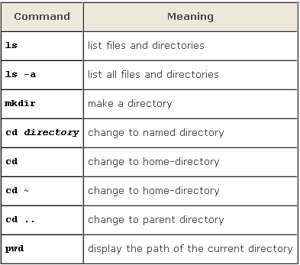
Here you →
2020-2021(even) Linux Commands

Slide 11
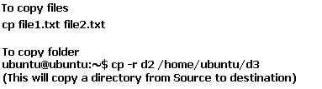

Chapter 2
Copying Files
2020-2021(even) Linux Commands

Slide 12
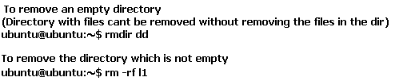
Removing Files and Directories
To delete (remove) a file, use the rm command.
% rm tempfile.txt
2020-2021(even) Linux Commands

Slide 13
Displaying the contents of a file on the screen
clear (clear screen)
Before you start the next section, you may like to clear the terminal window of the previous commands so the output of the following commands can be clearly understood.
At the prompt, type
% clear
This will clear all text and leave you with the % prompt at the top of the window.
2020-2021(even) Linux Commands

Slide 14
Let me catch the CAT’s HEAD and TAIL
cat (concatenate)
The command cat can be used to display the contents of a file on the screen. Type:
% cat science.txt
If the file is longer than the size of the window, so it scrolls past making it unreadable.
less
The command less writes the contents of a file onto the screen a page at a time. Type
% less science.txt
Press the [space-bar] if you want to see another page, and type [q] if you want to quit reading. As you can see, less is used in preference to cat for long files.
head
The head command writes the first ten lines of a file to the screen.
First clear the screen then type
% head science.txt
Then type
% head -5 science.txt
What difference did the -5 do to the head command?
tail
The tail command writes the last ten lines of a file to the screen.
Clear the screen and type
% tail science.txt
ANSWER THIS NOW:
Q. How can you view the last 15 lines of the file?
2020-2021(even) Linux Commands

Slide 15
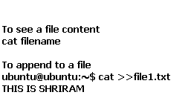
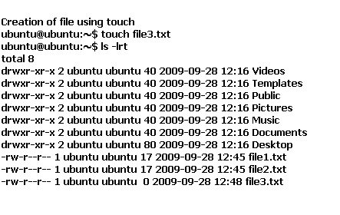
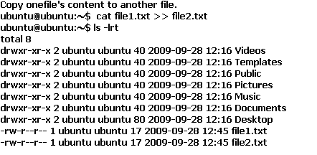
The CAT has grown bigger
2020-2021(even) Linux Commands

Slide 16
Lets Count - WC
wc (word count)
A handy little utility is the wc command, short for word count. To do a word count on science.txt, type
% wc -w science.txt
To find out how many lines the file has, type
% wc -l science.txt
grep () - "global regular expression printer"
grep is one of many standard UNIX utilities. It searches files for specified words or patterns. First clear the screen, then type
% grep science science.txt
2020-2021(even) Linux Commands

Slide 17
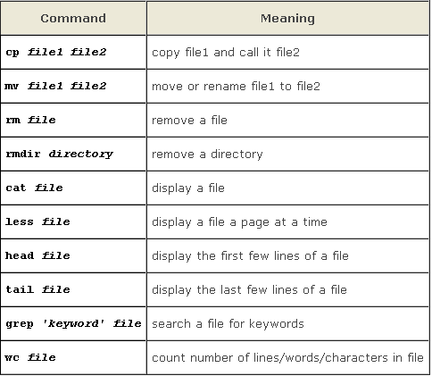
Here you →
2020-2021(even) Linux Commands

Slide 18
Chapter – 3
Re direction
Most processes initiated by UNIX commands write to the standard output (that is, they write to the terminal screen), and many take their input from the standard input (that is, they read it from the keyboard). There is also the standard error, where processes write their error messages, by default, to the terminal screen.
We have already seen one use of the cat command to write the contents of a file to the screen.
Now type cat without specifying a file to read
% cat
Then type a few words on the keyboard and press the [Return] key.
Finally hold the [Ctrl] key down and press [d] (written as ^D for short) to end the input.
What has happened?
If you run the cat command without specifying a file to read, it reads the standard input (the keyboard), and on receiving the 'end of file' (^D), copies it to the standard output (the screen).
In UNIX, we can redirect both the input and the output of commands.
2020-2021(even) Linux Commands

Slide 19
Re - direction
We will now use the cat command to join (concatenate) list1 and list2 into a new file called biglist. Type
% cat list1 list2 > biglist
What this is doing is reading the contents of list1 and list2 in turn, then outputing the text to the file biglist
To read the contents of the new file, type % cat biglist
2020-2021(even) Linux Commands

Slide 20

Let the water flow - PIPES
To see who is on the system with you, type
% who
One method to get a sorted list of names is to type,
% who > names.txt
% sort < names.txt
What you really want to do is connect the output of the who command directly to the input of the sort command. This is exactly what pipes do. The symbol for a pipe is the vertical bar |
For example, typing
% who | sort
will give the same result as above, but quicker and cleaner.
To find out how many users are logged on, type
% who | wc -l
2020-2021(even) Linux Commands

Slide 21
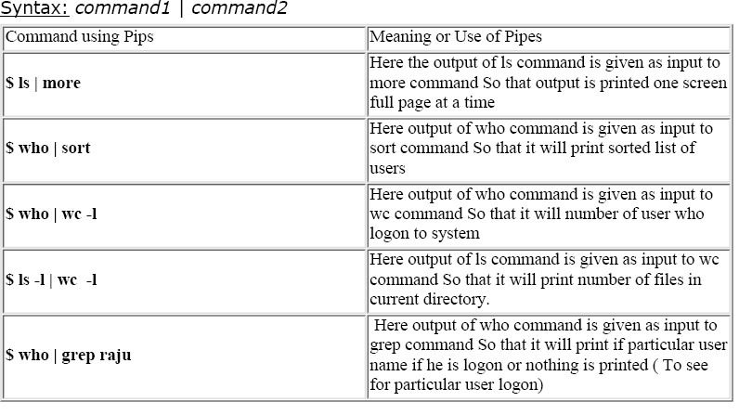
Contd.,
2020-2021(even) Linux Commands

Slide 22
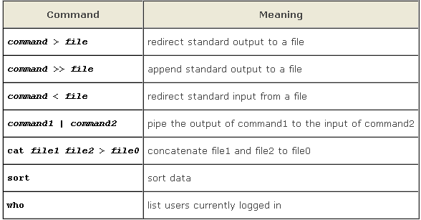
Here you →
2020-2021(even) Linux Commands

Slide 23
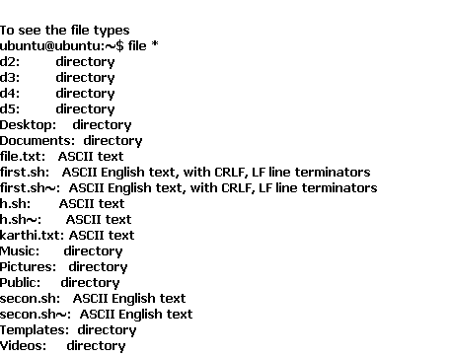
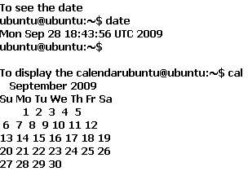

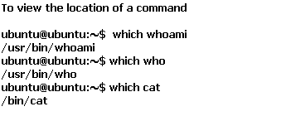
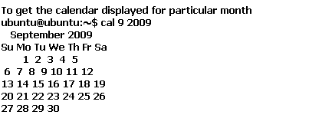
Chapter 4
Few New Intros
2020-2021(even) Linux Commands

Slide 24
Wildcards
The * wildcard
The character * is called a wildcard, and will match against none or more character(s) in a file (or directory) name. For example, in your directory, type
    % ls list*
This will list all files in the current directory starting with list....
Try typing
% ls *list
This will list all files in the current directory ending with ....list
2020-2021(even) Linux Commands

Slide 25
Wildcards
The ? wildcard
The character ? will match exactly one character.
So ?ouse will match files like house and mouse, but not grouse.
Try typing
% ls ?list
2020-2021(even) Linux Commands

Slide 26
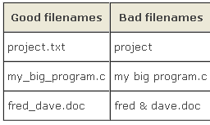
Filename conventions
2020-2021(even) Linux Commands

Slide 27
MAN can HELP you to know WHATIS this! - On-line Manuals
There are on-line manuals which gives information about most commands. The manual pages tell you which options a particular command can take, and how each option modifies the behaviour of the command. Type man command to read the manual page for a particular command.
For example, to find out more about the wc (word count) command, type
% man wc
Alternatively
% whatis wc
gives a one-line description of the command, but omits any information about options etc.
And u can do man man ☺
2020-2021(even) Linux Commands

Slide 28
Are you appropriate?
Apropos
When you are not sure of the exact name of a command,
% apropos keyword
will give you the commands with keyword in their manual page header. For example, try typing
% apropos date
2020-2021(even) Linux Commands

Slide 29
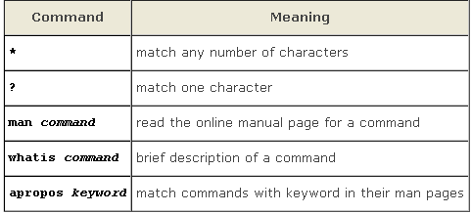
Here you →
2020-2021(even) Linux Commands

Slide 30
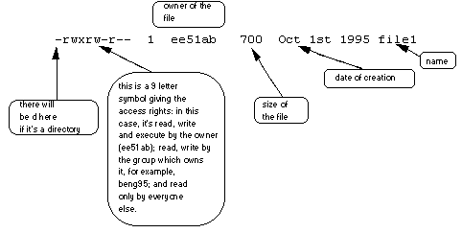
Chapter 5
File system security (access rights)
In your directory, type
% ls -l (l for long listing!)
2020-2021(even) Linux Commands

Slide 31
File system security (access rights)
Access rights on files.
r (or -), indicates read permission (or otherwise), that is, the presence or absence of permission to read and copy the file
w (or -), indicates write permission (or otherwise), that is, the permission (or otherwise) to change a file
x (or -), indicates execution permission (or otherwise), that is, the permission to execute a file, where appropriate
Access rights on directories.
r allows users to list files in the directory;
w means that users may delete files from the directory or move files into it;
x means the right to access files in the directory. This implies that you may read files in the directory provided you have read permission on the individual files.
2020-2021(even) Linux Commands

Slide 32
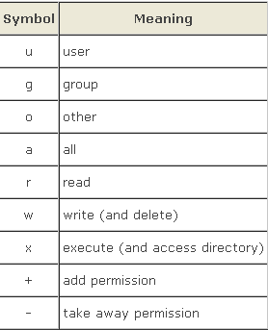
Changing access rights – Lets Change
chmod (changing a file mode)
Only the owner of a file can use chmod to change the permissions of a file. The options of chmod are as follows
2020-2021(even) Linux Commands

Slide 33
Changing access rights – Lets Change
For example, to remove read write and execute permissions on the file biglist for the group and others, type
% chmod go-rwx biglist
This will leave the other permissions unaffected.
To give read and write permissions on the file biglist to all,
% chmod a+rw biglist
2020-2021(even) Linux Commands

Slide 34
Processes and Jobs
A process is an executing program identified by a unique PID (process identifier). To see information about your processes, with their associated PID and status, type
    % ps
A process may be in the foreground, in the background, or be suspended. In general the shell does not return the UNIX prompt until the current process has finished executing.
Some processes take a long time to run and hold up the terminal.
Backgrounding a long process has the effect that the UNIX prompt is returned immediately, and other tasks can be carried out while the original process continues executing.
2020-2021(even) Linux Commands

Slide 35
Processes and Jobs
Running background processes
To background a process, type an & at the end of the command line. For example, the command sleep waits a given number of seconds before continuing. Type
% sleep 10
This will wait 10 seconds before returning the command prompt %. Until the command prompt is returned, you can do nothing except wait.
To run sleep in the background, type
% sleep 10 &
[1] 6259
The & runs the job in the background and returns the prompt straight away, allowing you do run other programs while waiting for that one to finish.
The first line in the above example is typed in by the user; the next line, indicating job number and PID, is returned by the machine.
The user is be notified of a job number (numbered from 1) enclosed in square brackets, together with a PID and is notified when a background process is finished.
Backgrounding is useful for jobs which will take a long time to complete.
2020-2021(even) Linux Commands

Slide 36
Backgrounding a current foreground process
You can suspend the process running in the foreground by typing ^Z, i.e.hold down the [Ctrl] key and type [z]. Then to put it in the background, type
% bg
Note: do not background programs that require user interaction e.g. vi
2020-2021(even) Linux Commands

Slide 37
listing suspended and background processes
When a process is running, backgrounded or suspended, it will be entered onto a list along with a job number. To examine this list, type
% jobs
An example of a job list could be
[1] Suspended sleep 1000
[2] Running netscape
[3] Running matlab
To restart (foreground) a suspended processes, type
% fg %jobnumber
For example, to restart sleep 1000, type
% fg %1
Typing fg with no job number foregrounds the last suspended process.
2020-2021(even) Linux Commands

Slide 38
Killing a process kill (terminate or signal a process)
It is sometimes necessary to kill a process (for example, when an executing program is in an infinite loop)
To kill a job running in the foreground, type ^C (control c). For example, run
% sleep 100
^C
2020-2021(even) Linux Commands

Slide 39
ps (process status)
Alternatively, processes can be killed by finding their process numbers (PIDs) and using kill PID_number
% sleep 1000 &
% ps
PID TT S TIME COMMAND
20077 pts/5 S 0:05 sleep 1000
21563 pts/5 T 0:00 netscape
21873 pts/5 S 0:25 nedit
To kill off the process sleep 1000, type
% kill 20077
and then type ps again to see if it has been removed from the list.
If a process refuses to be killed, uses the -9 option, i.e. type
% kill -9 20077
Note: It is not possible to kill off other users' processes !!!
2020-2021(even) Linux Commands

Slide 40
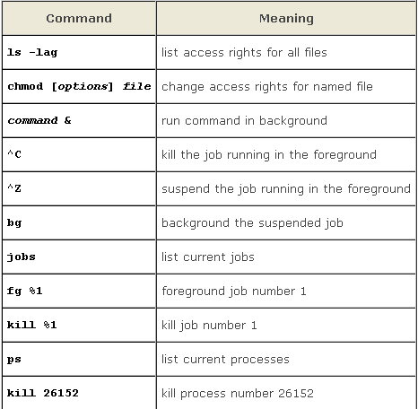
Here U →
<-- (Lets Recap here)
2020-2021(even) Linux Commands

Slide 41
CHAPTER 6
FEW MORE USEFUL COMMANDS
quota
All students are allocated a certain amount of disk space on the file system for their personal files, usually about 100Mb. If you go over your quota, you are given 7 days to remove excess files.
To check your current quota and how much of it you have used, type
  % quota -v
Uname –a
This will let u know which version of linux are u using!
du
The du command outputs the number of kilobyes used by each subdirectory. Useful if you have gone over quota and you want to find out which directory has the most files. In your home-directory, type
% du -s *
The -s flag will display only a summary (total size) and the * means all files and directories.
2020-2021(even) Linux Commands

Slide 42
Contd.,
gzip
This reduces the size of a file, thus freeing valuable disk space. For example, type
% ls -l science.txt
and note the size of the file using ls -l . Then to compress science.txt, type
% gzip science.txt
This will compress the file and place it in a file called science.txt.gz
To see the change in size, type ls -l again.
To expand the file, use the gunzip command.
% gunzip science.txt.gz
zcat
zcat will read gzipped files without needing to uncompress them first.
% zcat science.txt.gz
If the text scrolls too fast for you, pipe the output though less .
% zcat science.txt.gz | less
diff
This command compares the contents of two files and displays the differences. Suppose you have a file called file1 and you edit some part of it and save it as file2. To see the differences type
% diff file1 file2
2020-2021(even) Linux Commands

Slide 43
History is important ☺
% history (show command history list)
% !! (recall last command)
% !-3 (recall third most recent command)
% !5 (recall 5th command in list)
% !grep (recall last command starting with grep)
You can increase the size of the history buffer by typing
% set history=100
2020-2021(even) Linux Commands

Slide 44
Chapter 7
We are nearing to end☺
environment Variables
An example of an environment variable is the OSTYPE variable. The value of this is the current operating system you are using. Type
  % echo $OSTYPE
More examples of environment variables are
  USER (your login name)
  HOME (the path name of your home directory)
  HOST (the name of the computer you are using)
  ARCH (the architecture of the computers processor)
  DISPLAY (the name of the computer screen to display X windows)
  PRINTER (the default printer to send print jobs)
  PATH (the directories the shell should search to find a command)
2020-2021(even) Linux Commands

Slide 45
Finding out the current values of these variables.
ENVIRONMENT variables are set using the setenv command, displayed using the printenv or env commands, and unset using the unsetenv command.
To show all values of these variables, type
    % printenv | less
2020-2021(even) Linux Commands

Slide 46

What is Process??
Let`s have some food for brain ☺
2020-2021(even) Linux Commands

Slide 47
What is Process?? - Most important thing to know
Process is any kind of program or task carried out by your PC. For e.g. $ ls -lR , is command or a request to list files in a directory and all subdirectory in your current directory. It is a process.
A process is program (command given by user) to perform some Job.
In Linux when you start process, it gives a number (called PID or process-id), PID starts from 0 to 65535.
2020-2021(even) Linux Commands

Slide 48
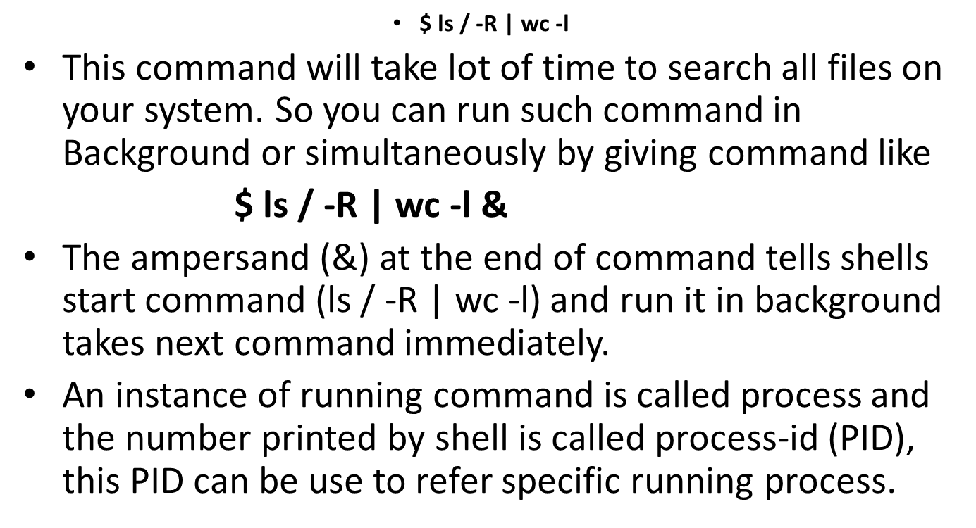
Contd.,
2020-2021(even) Linux Commands

Slide 49
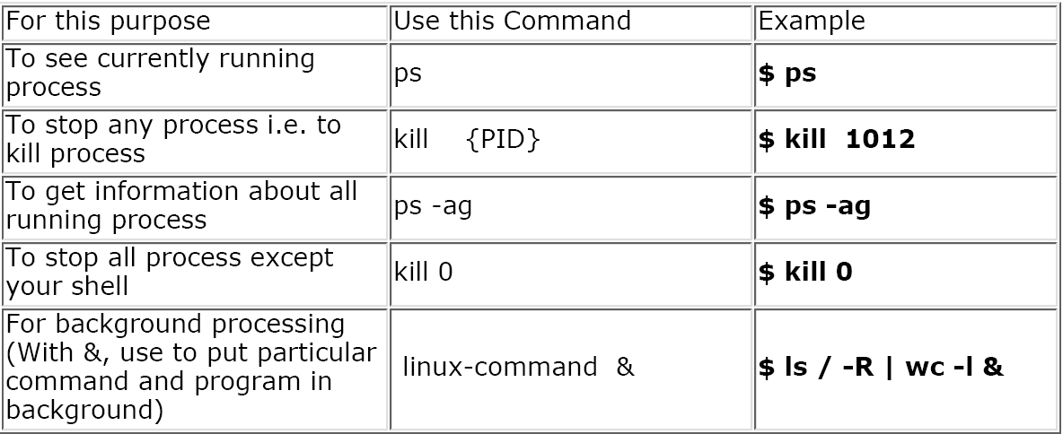
Process Related Commands
NOTE that you can only kill process which are created by yourself. A Administrator can almost kill 95-98% process. But some process can not be killed, such as VDU Process.
2020-2021(even) Linux Commands

Slide 50
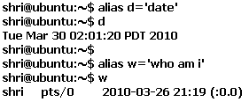
Advanced Commands in Alphabetical Order
1. Alias
2020-2021(even) Linux Commands

Slide 51
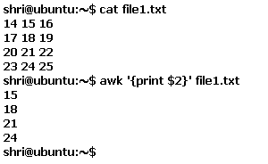
AWK
awk command is used to manipulate the text. This command checks each line of a file, looking for patterns that match those given on the command line.
2020-2021(even) Linux Commands

Slide 52
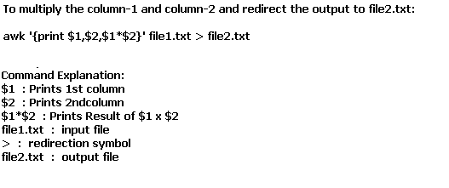
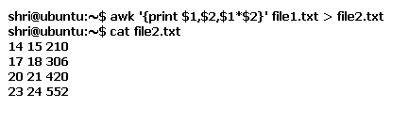
AWK – Slight Improvement
2020-2021(even) Linux Commands

Slide 53
Bc – Basic Calculator
shri@ubuntu:~$ bc -l
bc 1.06.94
Copyright 1991-1994, 1997, 1998, 2000, 2004, 2006 Free Software Foundation, Inc.
This is free software with ABSOLUTELY NO WARRANTY.
For details type `warranty'.
1+2
3
3+2
5
quit
bc command is used for command line calculator. It is similar to basic calculator. By using which we can do basic mathematical calculations.
shri@ubuntu:~$ cat > file1.txt
1 + 2
quit
shri@ubuntu:~$ bc file1.txt
bc 1.06.94
Copyright 1991-1994, 1997, 1998, 2000, 2004, 2006 Free Software Foundation, Inc.
This is free software with ABSOLUTELY NO WARRANTY.
For details type `warranty'.
3
shri@ubuntu:~$
shri@ubuntu:~$ bc
bc 1.06.94
Copyright 1991-1994, 1997, 1998, 2000, 2004, 2006 Free Software Foundation, Inc.
This is free software with ABSOLUTELY NO WARRANTY.
For details type `warranty'.
9*2
18
9+2
11
10-10
0
Quit - Will take you out of the calculator.
2020-2021(even) Linux Commands

Slide 54
Bg and jobs
It is helpful to list the jobs that are running in the background.
shri@ubuntu:~$ jobs
[1]+ Running gedit file1.txt &
shri@ubuntu:~$ bg
bash: bg: job 1 already in background
shri@ubuntu:~$
2020-2021(even) Linux Commands

Slide 55
Lets zip it
bzip2 COMMAND:
bzip2 linux command is used to compress the file. Each file is replaced by a compressed version of itself with .bz2 extension
Now Zipping
shri@ubuntu:~$ cat file1.txt
1 + 2
Quit
shri@ubuntu:~$ bzip2 -c -1 file1.txt > file1.txt.bz2
shri@ubuntu:~$ ls -lrt | grep *.bz2
-rw-r--r-- 1 shri shri 54 2010-03-30 02:42 file1.txt.bz2
shri@ubuntu:~$
Now Zipping Better
$ bzip2 -c -9 hiox.txt > hscripts.txt.bz2
$ ls -l
-rw-rw-r-- 1 hiox hiox 9150000 Sep 26 18:37 hiox.txt
-rw-rw-r-- 1 hiox hiox 17706 Sep 27 12:38 hiox.txt.bz2
-rw-rw-r-- 1 hiox hiox 2394 Sep 27 13:01 hscripts.txt.bz2
- 1 Performs fast compression,creating a relatively large files. This is an important option over here
When the file is compressed with -1 the size was 17706 bytes and now the filesize is 2394 bytes. The 9 makes best compression but the default is 6.
2020-2021(even) Linux Commands

Slide 56
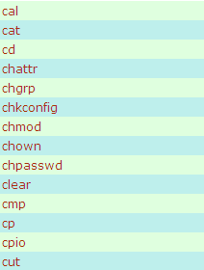
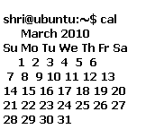
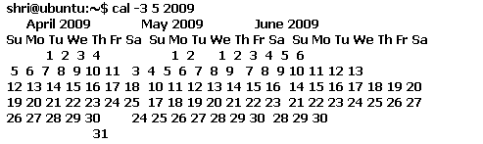
Lets Catch ‘C’
CALENDAR - CAL
2020-2021(even) Linux Commands

Slide 57
C - Here
We have spent time on Cat, cd, cp, clear, Cal and chmod.
So let us see rest of the advanced commands here.
2020-2021(even) Linux Commands

Slide 58
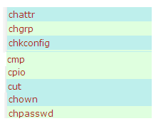
Going advanced …
chattr COMMAND:
chattr command is used to change the file attributes. This is an admin command. Root user only can change the file attributes/Process.
+i Make the file as Read-Only.
-i Remove the Read-Only.
+a Can't open file for writing.
-a Open file for writing.
$chattr +a file1.txt
$chattr: Operation not permitted while setting flags on file1.tx
As this is an Admin commands.. We got the above message!
2020-2021(even) Linux Commands

Slide 59
Going advanced
chgrp COMMAND:
chgrp command is used to change the group of the file or directory. This is an admin command. Root user only can change the group of the file or directory.
This is again a privileged command. So cant make use of it.
2020-2021(even) Linux Commands

Slide 60
Going advanced
chown COMMAND:
chown command is used to change the owner / user of the file or directory. This is an admin command, root user only can change the owner of a file or directory.
SYNTAX:
The Syntax is chown [options] newowner filename/directoryname
The owner of the ‘file1.txt' file is shri, Change to new user root.
-rw-r--r-- 1 shri shri 12 2010-03-30 02:34 file1.txt
shri@ubuntu:~$ chown root file1.txt
chown: changing ownership of `file1.txt': Operation not permitted
2020-2021(even) Linux Commands

Slide 61
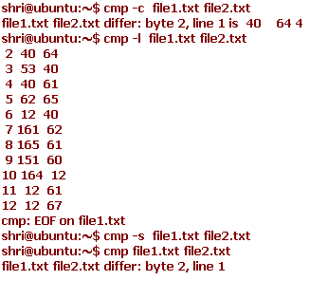
Cmp command
cmp COMMAND:
cmp linux command compares two files and tells you which line numbers are different.
SYNTAX:
The Syntax is
cmp [options..] file1 file2
OPTIONS:
- c Output differing bytes as characters.
l Print the byte number (decimal) and the differing byte values (octal) for each difference.
- s Prints nothing for differing files, return exit status only.
2020-2021(even) Linux Commands

Slide 62
cut
cut COMMAND:
cut command is used to cut out selected fields of each line of a file. The cut command uses delimiters to determine where to split fields.
SYNTAX:
The Syntax is
cut [options]
OPTIONS:
-c Specifies character positions. -b Specifies byte positions.
EXAMPLE:
Lets create a file file1.txt and let it have the following data:
Data in file1.txt
This is, an example program,for cut command.
cut -c1-3 text.txt
Output:
Thi
Cut the first three letters from the above line.
2020-2021(even) Linux Commands

Slide 63
LETS GET INTO D
df COMMAND:
df command is used to report how much free disk space is available for each mount you have. The first column show the name of the disk partition as it appears in the /dev directory. Subsequent columns show total space, blocks allocated and blocks available.
shri@ubuntu:~$ df
Filesystem 1K-blocks Used Available Use% Mounted on
/dev/sda1 4878132 2476452 2153880 54% /
udev 254668 224 254444 1% /dev
none 254668 180 254488 1% /dev/shm
none 254668 92 254576 1% /var/run
none 254668 0 254668 0% /var/lock
none 254668 0 254668 0% /lib/init/rw
shri@ubuntu:~$
date command
date
The above command will print
Wed Jul 23 10:52:34 IST 2008
2020-2021(even) Linux Commands

Slide 64
LETS GET INTO D
shri@ubuntu:~$ du
76 ./.gconfd
8 ./.cache/gedit
28 ./.cache
116 ./.mozilla/firefox/day8z6r3.default/Cache
4 ./.mozilla/firefox/day8z6r3.default/extensions
12 ./.mozilla/firefox/day8z6r3.default/chrome
12 ./.mozilla/firefox/day8z6r3.default/bookmarkbackups
3932 ./.mozilla/firefox/day8z6r3.default
3940 ./.mozilla/firefox
4 ./.mozilla/extensions/{ec8030f7-c20a-464f-9b0e-13a3a9e97384}
8 ./.mozilla/extensions
3952 ./.mozilla
4 ./.gnome2_private
4 ./t12
12 ./.update-manager-core
8 ./.gnome2/gedit
4 ./.gnome2/nautilus-scripts
4 ./.gnome2/panel2.d/default/launchers
8 ./.gnome2/panel2.d/default
12 ./.gnome2/panel2.d
8 ./.gnome2/keyrings
28 ./.gnome2/accels
64 ./.gnome2
4 ./Documents
20 ./.thumbnails/normal
24 ./.thumbnails
0 ./.gvfs
4 ./.update-notifier
4 ./.config/gnome-session/saved-session
8 ./.config/gnome-session
du command is used to report how much disk space a file or directory occupies.
2020-2021(even) Linux Commands

Slide 65
E – Only Echo!
2020-2021(even) Linux Commands

Slide 66
F
Fg:
fg command is used to place a job in foreground.
Run some process in background.Use fg… the process will be brought to foreground.
shri@ubuntu:~$ gedit file1.txt &
[1] 4970
shri@ubuntu:~$ fg 1
gedit file1.txt
2020-2021(even) Linux Commands

Slide 67
F - Finger
shri@ubuntu:~$ finger
Login Name Tty Idle Login Time Office Office Phone
shri shriram tty7 4d Mar 26 20:02 (:0)
shri shriram pts/0 Mar 26 21:19 (:0.0)
shri@ubuntu:~$
shri@ubuntu:~$ finger shri
Login: shri Name: shriram
Directory: /home/shri Shell: /bin/bash
On since Fri Mar 26 20:02 (PDT) on tty7 from :0
4 days 11 hours idle
On since Fri Mar 26 21:19 (PDT) on pts/0 from :0.0
No mail.
No Plan.
finger command displays the user's login name, real name, terminal name and write status (as a ''*'' after the terminal name if write permission is denied), idle time, login time, office location and office phone number
2020-2021(even) Linux Commands

Slide 68
File..
file COMMAND:
file command tells you if the object you are looking at is a file or a directory.
File * will list you the types of files available in that system.
shri@ubuntu:~$ file *.txt
f1.txt: ASCII text
f2.txt: ASCII text
file1.txt: ASCII text
file2.txt: ASCII text
file_t1.txt: empty
file_t2.txt: empty
file.txt: ASCII text
linux.txt: ASCII text
result.txt: ASCII text
shriram.txt: ASCII text
test2.txt: ASCII text
2020-2021(even) Linux Commands

Slide 69
You are free after this slide.
free COMMAND:
free command displays information about free and used memory on the system.
shri@ubuntu:~$ free
total used free shared buffers cached
Mem: 509336 480580 28756 0 140528 189548
-/+ buffers/cache: 150504 358832
Swap: 281096 48 281048
shri@ubuntu:~$
2020-2021(even) Linux Commands

Slide 70

G
All these are used to Add groups, Delete Groups, Modify an Existing group etc., as all these are admin commands you will end up in not having permission for executing these commands..
Typing groups will get u the details of all the available groups in you system.
shri@ubuntu:~$ groups
shri adm dialout cdrom plugdev lpadmin admin sambashare
2020-2021(even) Linux Commands

Slide 71
Can We Halt? – System Related Commands
To halt the system:
halt
This command is similar to poweroff, which shutdown the system.
To Poweroff the system:
poweroff
Poweroff command used for turnoff the system.
To reboot the system:
reboot
Reboot command used for reboots/restarts the system.
2020-2021(even) Linux Commands

Slide 72
Host
host COMMAND:
host command is used to find the ip address of the given domain name and also prints the domain name for the given ip.
shri@ubuntu:~$ host vit.ac.in
vit.ac.in has address 192.168.64.3
vit.ac.in mail is handled by 5 alt1.aspmx.l.google.com.\032.
vit.ac.in mail is handled by 5 alt2.aspmx.l.google.com.
vit.ac.in mail is handled by 10 aspmx2.googlemail.com.\032.
vit.ac.in mail is handled by 10 aspmx3.googlemail.com.\032.
vit.ac.in mail is handled by 10 aspmx4.googlemail.com.\032.
vit.ac.in mail is handled by 10 aspmx5.googlemail.com.\032.
vit.ac.in mail is handled by 1 aspmx.l.google.com.\032.
shri@ubuntu:~$ host yahoo.co.in
yahoo.co.in has address 68.180.206.184
yahoo.co.in has address 206.190.60.37
yahoo.co.in mail is handled by 10 in32.mxauth.yahoo.com.
shri@ubuntu:~$ host 68.180.206.184
184.206.180.68.in-addr.arpa domain name pointer w2.rc.vip.sp1.yahoo.com.
shri@ubuntu:~$
2020-2021(even) Linux Commands

Slide 73
Host id and Host Name
hostid COMMAND:
hostid command prints the numeric identifier or id of the current host in hexadecimal.
SYNTAX:
The Syntax is
hostid
shri@ubuntu:~$ hostid
007f0101
shri@ubuntu:~$
hostid COMMAND:
hostid command prints the numeric identifier or id of the current host in hexadecimal.
SYNTAX:
The Syntax is
hostid
shri@ubuntu:~$ hostname
UBUNTU
shri@ubuntu:~$
2020-2021(even) Linux Commands

Slide 74
id
id COMMAND:
id command prints the effective(current) and real userid(UID)s and groupid(GID)s.
SYNTAX:
The Syntax is
id
shri@ubuntu:~$ id
uid=1000(shri) gid=1000(shri) groups=4(adm),20(dialout),24(cdrom),46(plugdev),104(lpadmin),115(admin),120(sambashare),1000(shri)
2020-2021(even) Linux Commands

Slide 75
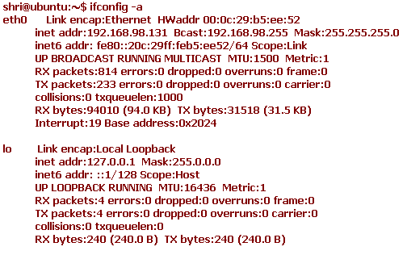
info
info command is used to display the readable online documentation for the specified command .
Typing just info will lead you screen to be filled with hell a lot of data!
shri@ubuntu:~$ info man
shri@ubuntu:~$ info cp
IFCONFIG
ifconfig command displays information about the network interfaces attached to the system and also used to configure the network interface.
To Assign IP address to Network Interface[Ethernet Card]:
ifconfig eth0 192.168.0.12 up
The above command will Assign IP address 192.168.0.12 to Ethernet card with name eth0.
To inactivate the Network Interface[Ethernet Card]:
ifconfig eth0 down
The above command inactivates the ethernet card.
2020-2021(even) Linux Commands

Slide 76
netstat
nestat command displays statistics information and current state of network connections, protocol, ports/ sockets and devices.
unix 3 [ ] STREAM CONNECTED 9803 @/tmp/dbus-3Imoh4QFZa
unix 3 [ ] STREAM CONNECTED 9802
unix 3 [ ] STREAM CONNECTED 9801 /tmp/orbit-shri/linc-7b7-0-28f9f13a74fe6
unix 3 [ ] STREAM CONNECTED 9800
unix 3 [ ] STREAM CONNECTED 9799 /tmp/orbit-shri/linc-773-0-455a56f8d87af
unix 3 [ ] STREAM CONNECTED 9796
unix 3 [ ] STREAM CONNECTED 9792 @/tmp/.X11-unix/X0
unix 3 [ ] STREAM CONNECTED 9791
unix 3 [ ] STREAM CONNECTED 9790 /tmp/orbit-shri/linc-7b6-0-3923529828c29
2020-2021(even) Linux Commands

Slide 77
route
route command displays routing table resides in kernel and also used to modify the routing table.
The tables which specifies how packets are routed to a host is called routing table.
shri@ubuntu:~$ route –n (Where –n is net)
Kernel IP routing table
Destination Gateway Genmask Flags Metric Ref Use Iface
192.168.98.0 0.0.0.0 255.255.255.0 U 1 0 0 eth0
0.0.0.0 192.168.98.2 0.0.0.0 UG 0 0 0 eth0
shri@ubuntu:~$
2020-2021(even) Linux Commands

Slide 78
Let me say bye to commands here!
Itz your turn ☺
2020-2021(even) Linux Commands

